Slide 1
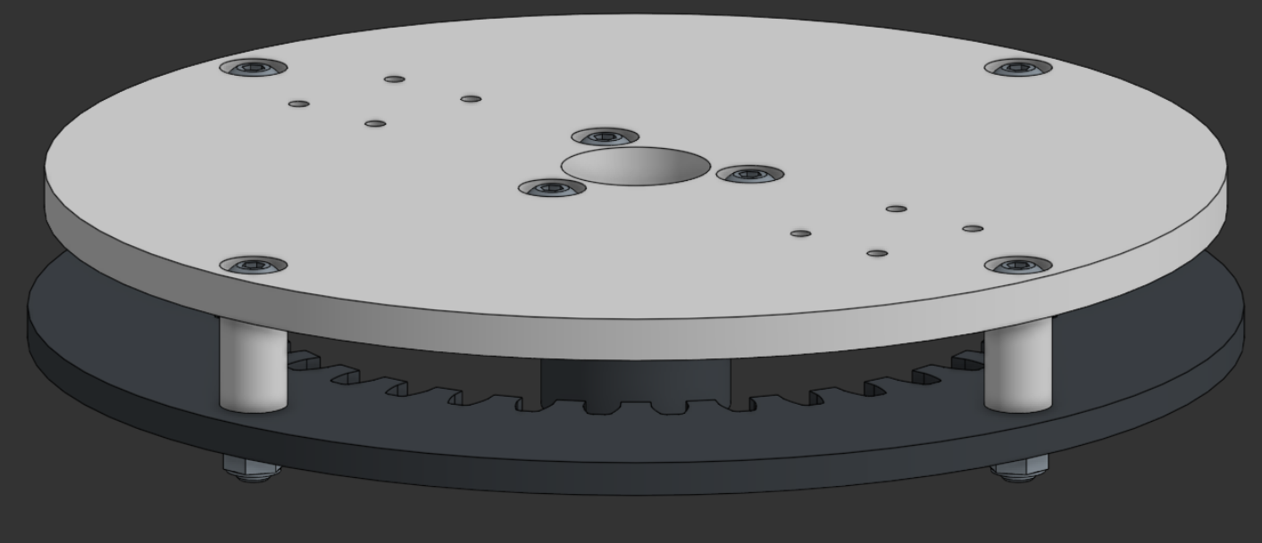
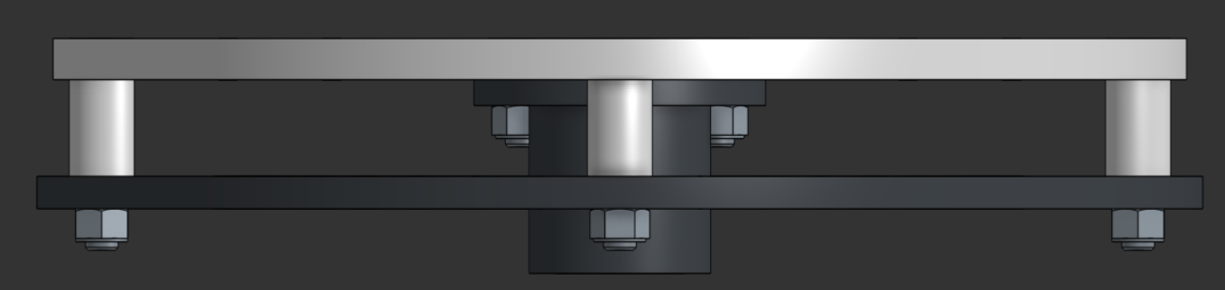
Arm Base Plate Assembly Instructions

Slide 2
Parts
Major Components:
Arm Base Plate
Wire Holder
36T Ring Gear
4x M5x10x20mm Spacer
Minor Components:
4x M5x30mm Button Head Bolt
3x M5x14mm Button Head Bolt
7x M5 Nylock Nuts

Slide 3
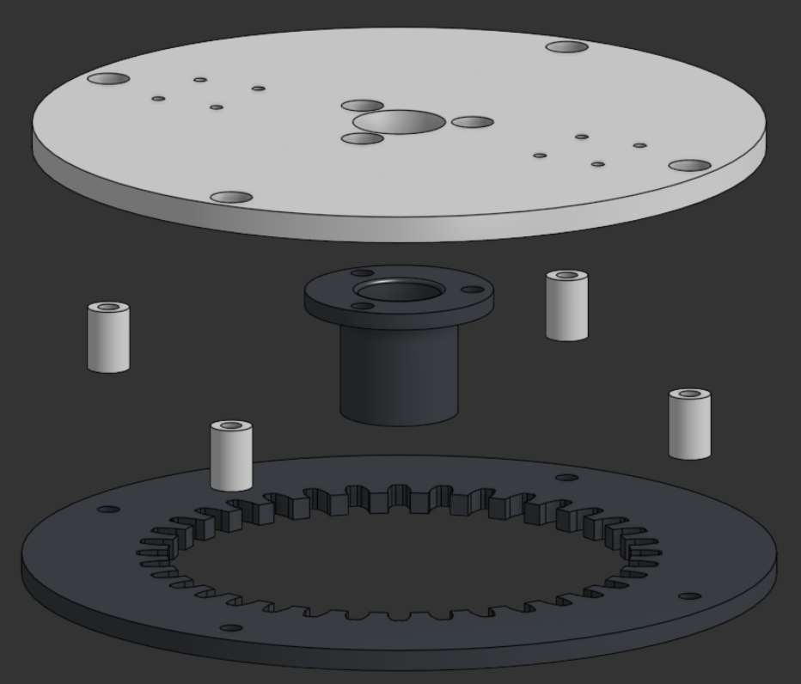
Major Components
Arm Base Plate
Wire Holder
14mm Spacers
36 Tooth Ring Gear

Slide 4
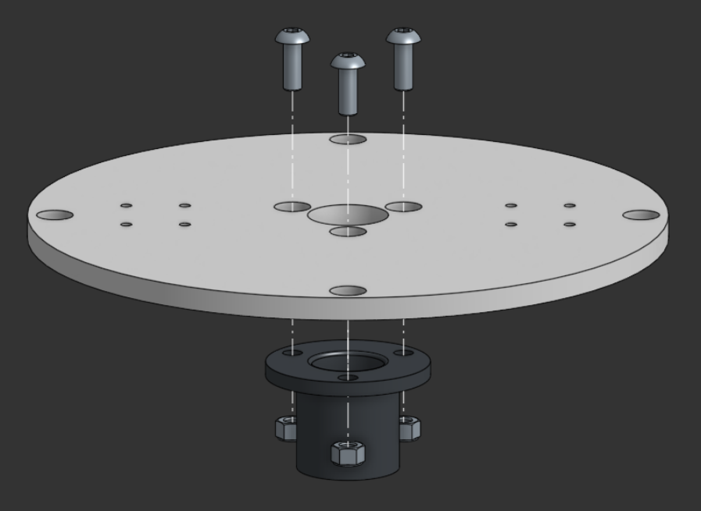
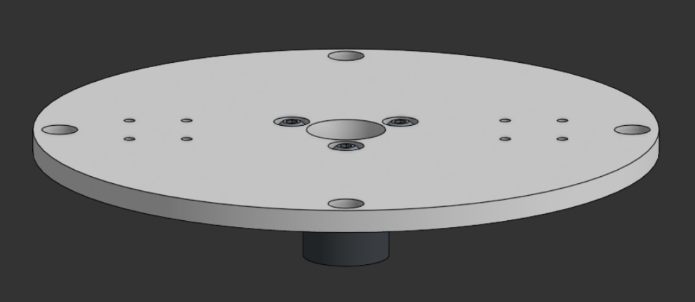
Step 1
Bolt the Wire Holder through the center of the Arm Base Plate
Parts
-Arm Base Plate
-Wire Holder
-3x M5x14mm Button Head Bolts
-3x M5 Nylock Nuts

Slide 5
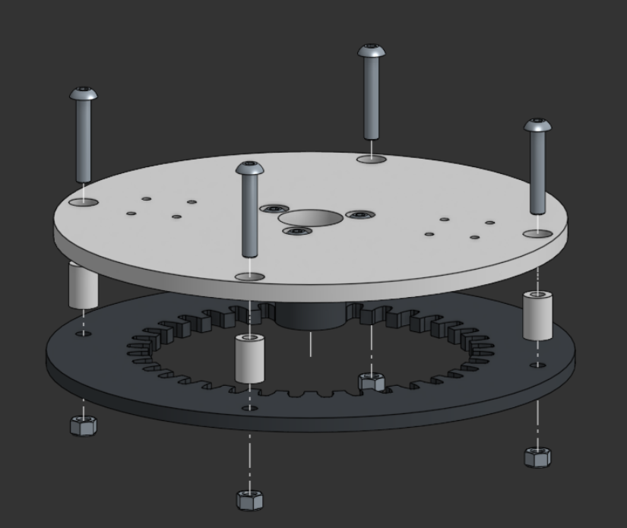
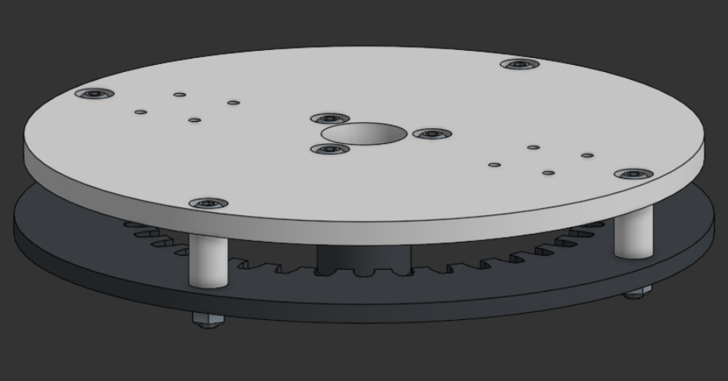
Step 2
Bolt the Arm Base Plate to the 36T Ring Gear with 20mm spacers in between
Parts
-Previous step
-4x M5x10x20mm Spacer
-4x M5x30mm Button Head Bolts
-4x M5 Nylock Nuts
-36T Ring Gear

Slide 6
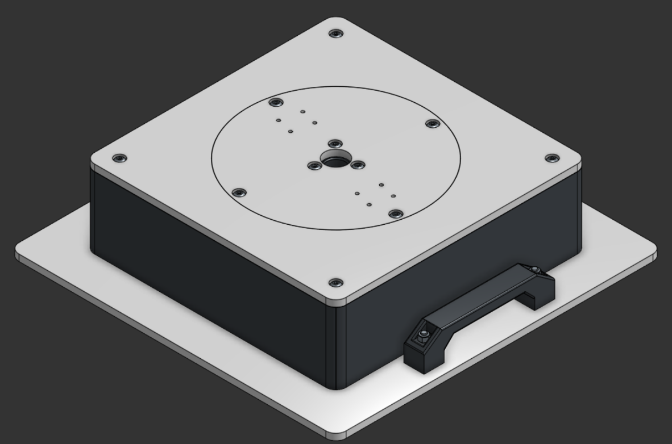
Arm Base Assembly Instructions

Slide 7
Parts
Major Components:
Arm Base Plate Assembly
Base Plate
Structure Plate
Base Top Plate
4x Base Wall
2x Base Handle
12T Ring Gear
Robotis XM540-W270-T Actuator

Slide 8
Parts Continued
Minor Components:
20x Nylock Nut
8x M5x14mm Button Head Bolt
4x M5x30mm Button Head Bolt
8x M5x30mm Socket Head Bolt
8x M5x60mm Button Head Bolt
4x M2.5x12mm Socket Head Bolt
4x M2.5x25mm Socket Head Bolt
8x 5x11x5mm Bearing
16x 5x16x5mm Bearing
4x 5x8x25mm M5 Threaded Spacers
8x 5x10x40mm M5 Threaded Spacers
4x Robotis Spacers

Slide 9
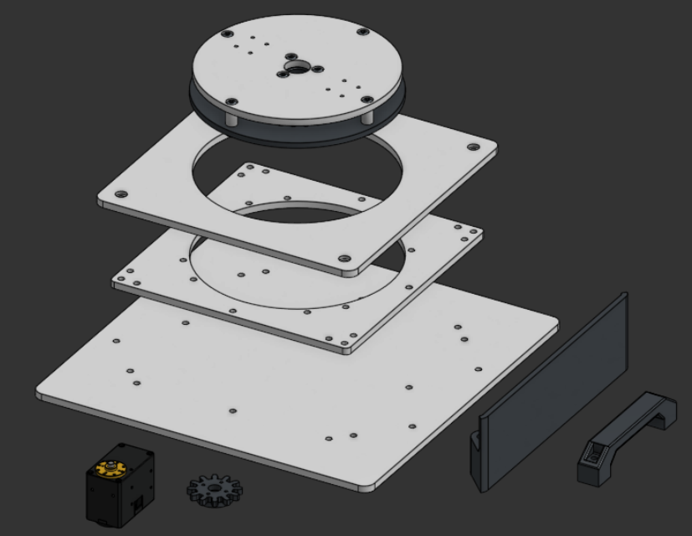
Major Components
Base Top Plate
Arm Base Plate
Assembly
Base Structure Plate
Base Wall
Base Plate
Base Handle
Robotis XM540-W270-T Actuator
12T gear + Gear Spacer

Slide 10
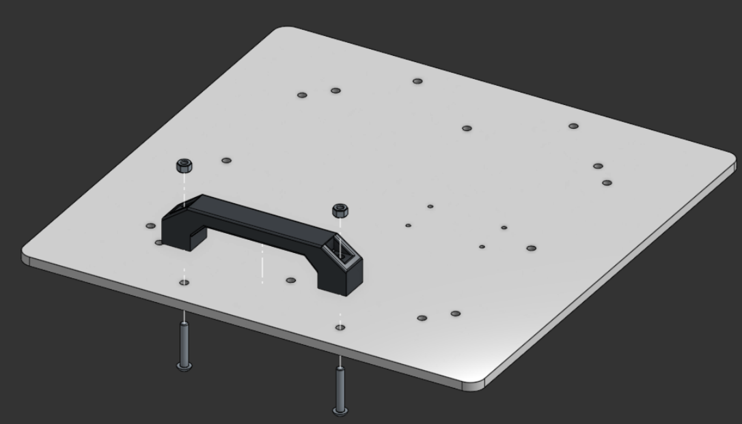
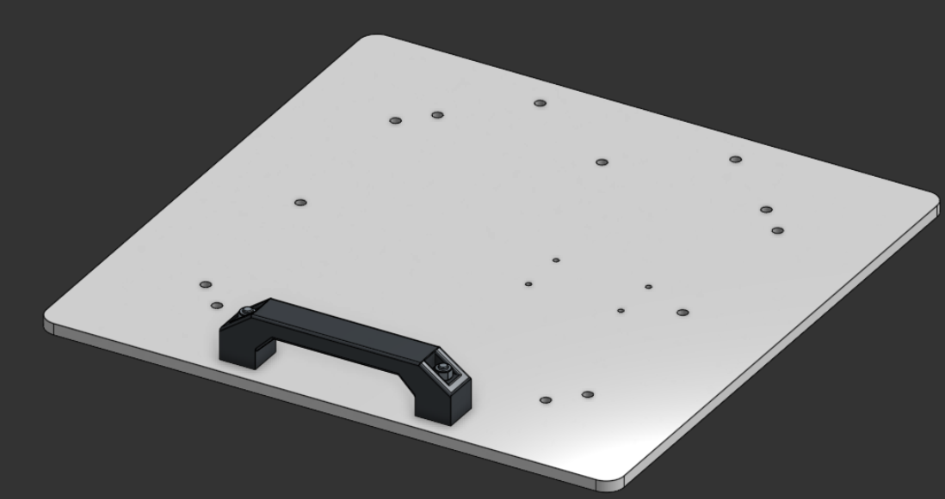
Step 1
Bolt the Base Handle to the edge of the Base Plate
Parts
-Base Plate
-Base Handle
-2x M5x30mm Button Head Bolt
-2x Nylock Nuts

Slide 11
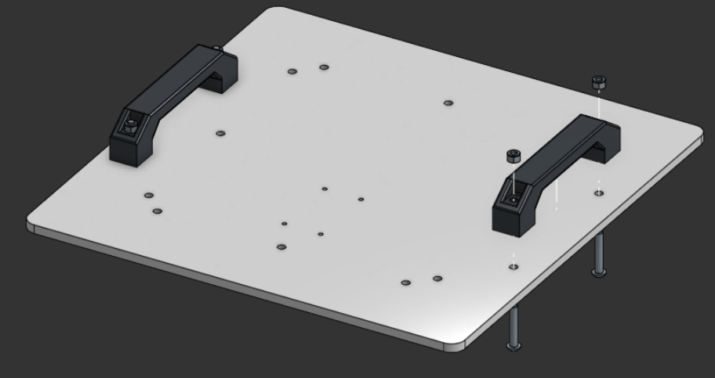
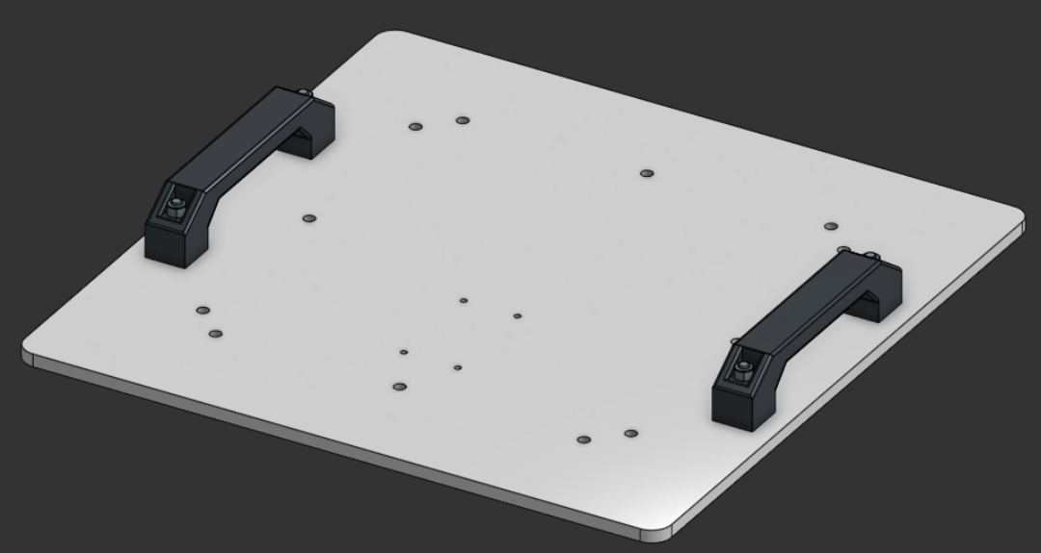
Step 2
Repeat for the other side
Parts
-Previous step
-Base Handle
-2x M5x30mm Button Head Bolt
-2x Nylock Nuts

Slide 12
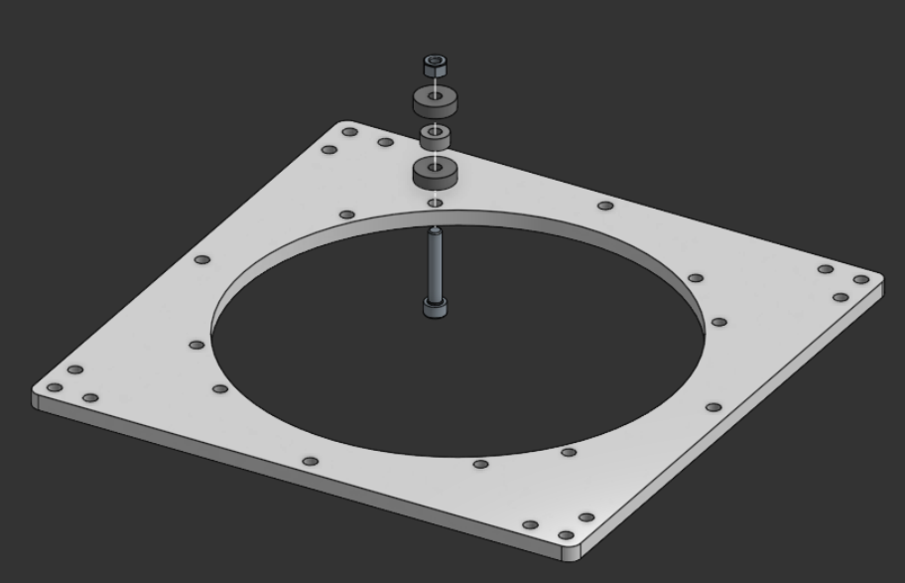
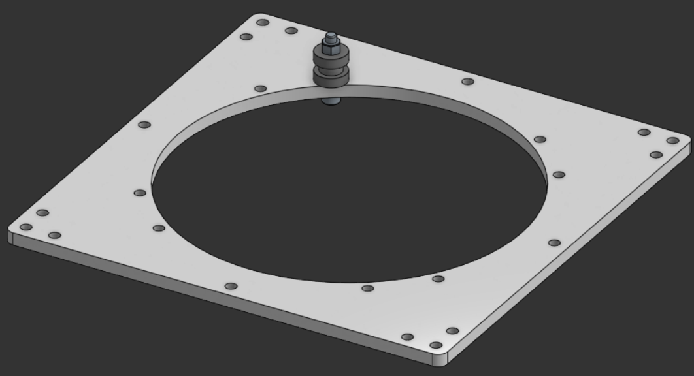
Step 3
Bolt a bearing stack (in the order of wide, thin, wide) around the center of the structure plate
Parts
-Structure Plate
-2x 5x16x5mm Bearing
-5x11x5mm Bearing
-M5x30mm Hex Socket Head Bolt
-Nylock Nut

Slide 13
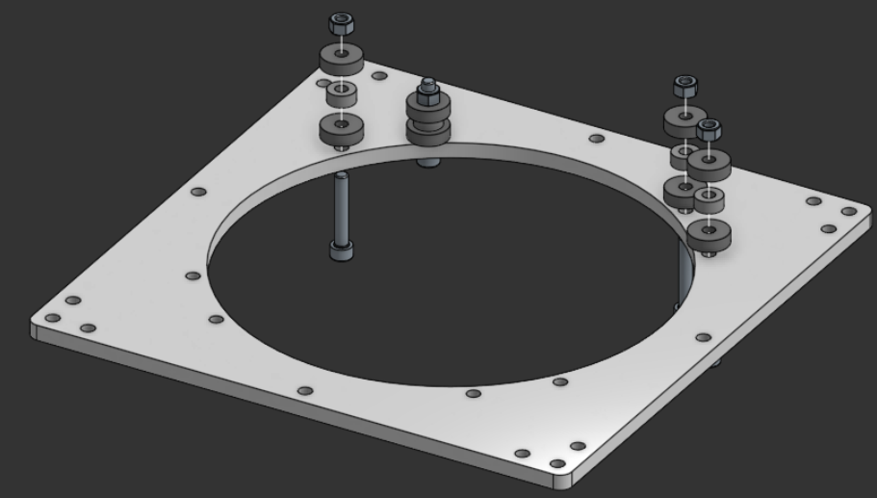
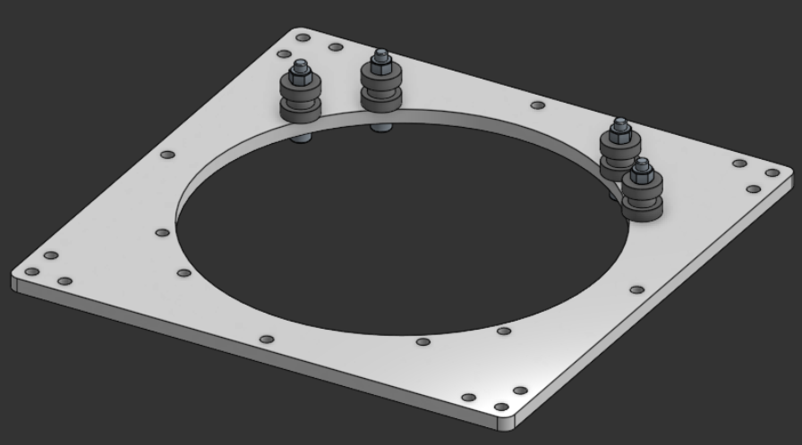
Step 4
Bolt 3 more bearing stacks around one half of the center of the structure plate
Parts
-Previous step
-6x 5x16x5mm Bearing
-3x 5x11x5mm Bearing
-3x M5x30mm Hex Socket Head Bolt
-3x Nylock Nut

Slide 14
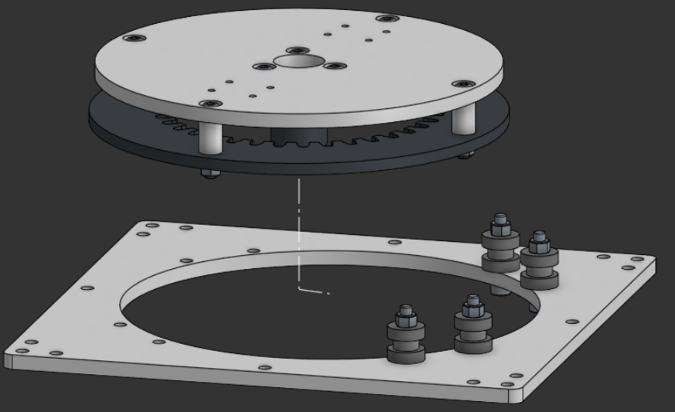
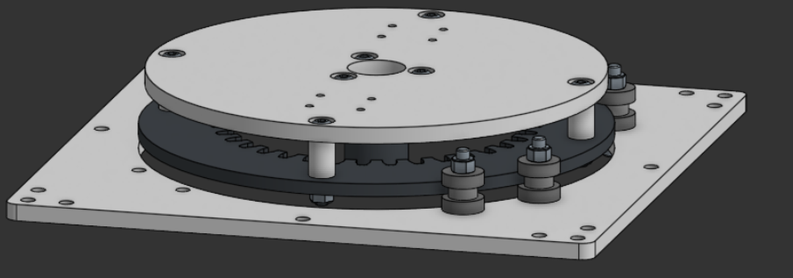
Step 5
Insert the Arm Base Assembly between the bearings in the bearing stacks
Parts
-Previous step
-Arm Base Assembly

Slide 15
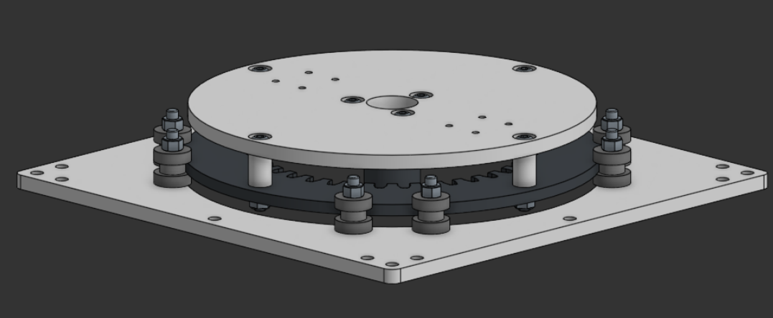
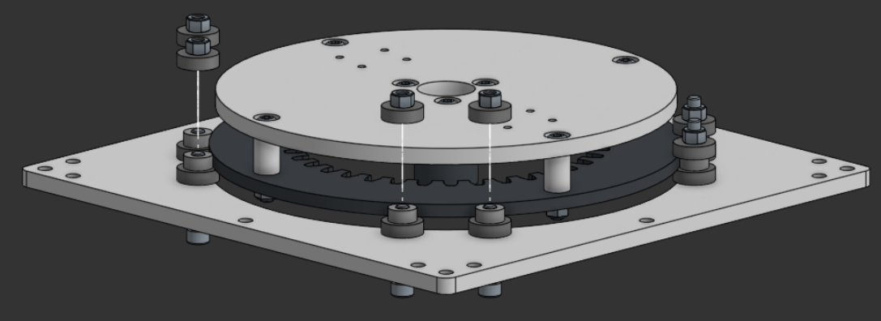
Step 6
Bolt four more bearing stacks around the other half of the structure plate
Parts
-Previous step
-8x 5x16x5mm Bearing
-4x 5x11x5mm Bearing
-4x M5x30mm Hex Socket Head Bolt
-4x Nylock Nut

Slide 16
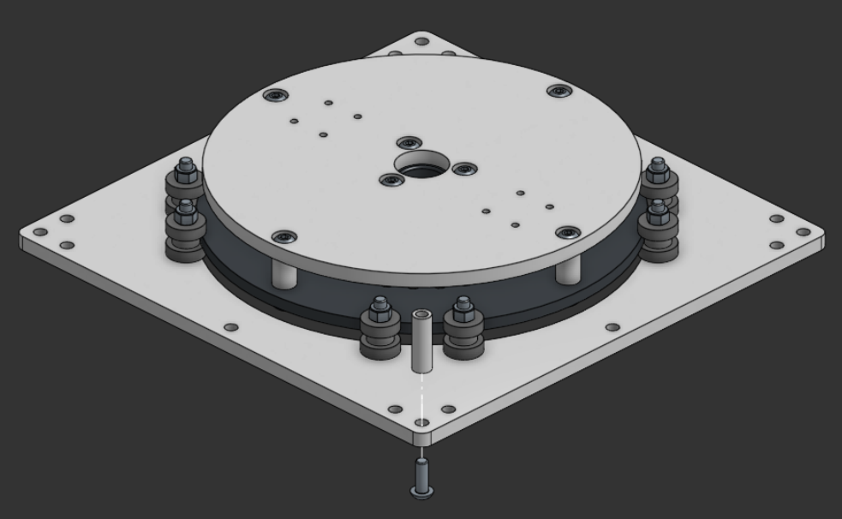
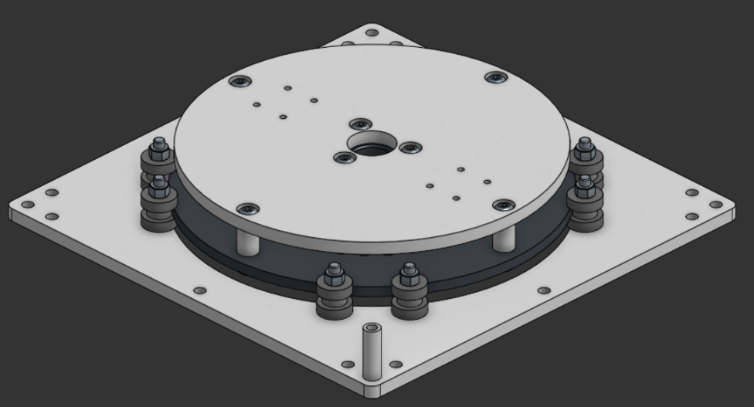
Step 7
Bolt a threaded spacer onto one corner of the Structure Plate
Parts
-Previous step
-5x8x25mm M5 Threaded Spacers
-M5x14mm Button Head Bolt

Slide 17
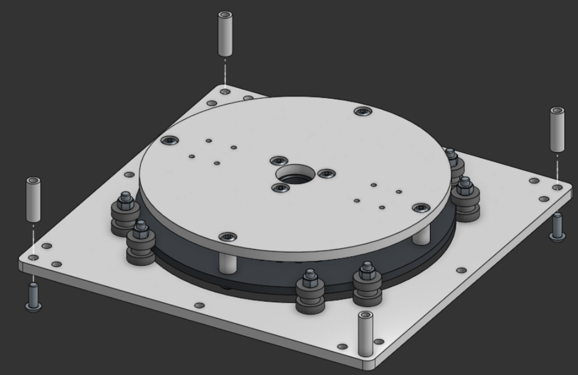
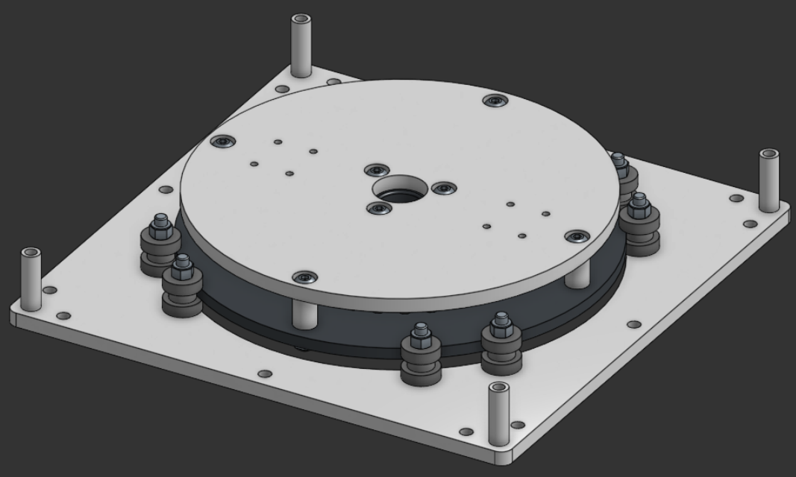
Step 8
Bolt threaded spacers on all other corners of the Structure Plate
Parts
-Previous step
-3x 5x8x25mm M5 Threaded Spacers
-3x M5x14mm Button Head Bolt

Slide 18
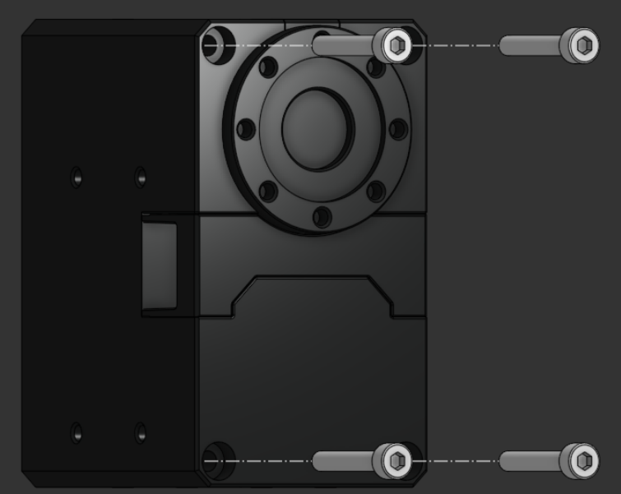
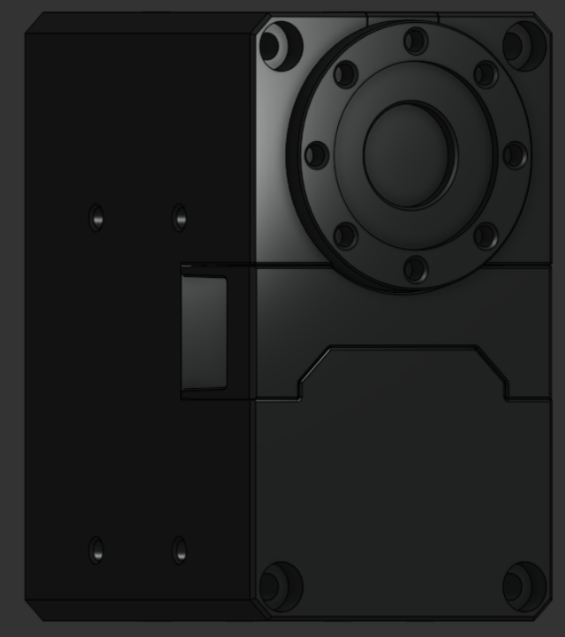
Step 9
Remove the four bolts on the back of the actuator
Parts
-Robotis XM540-W270-T Actuator

Slide 19
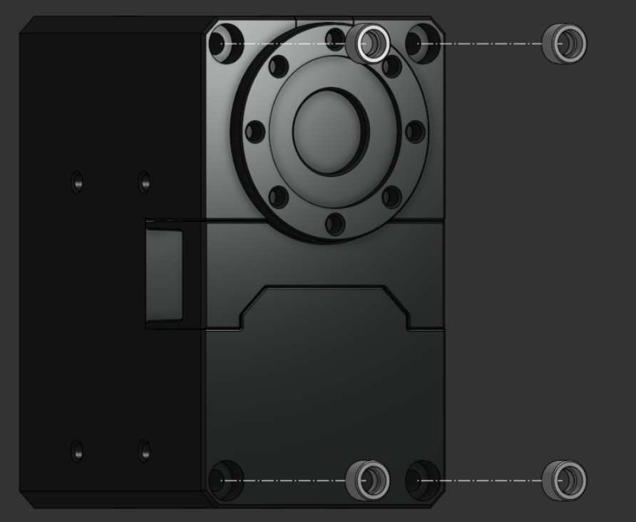
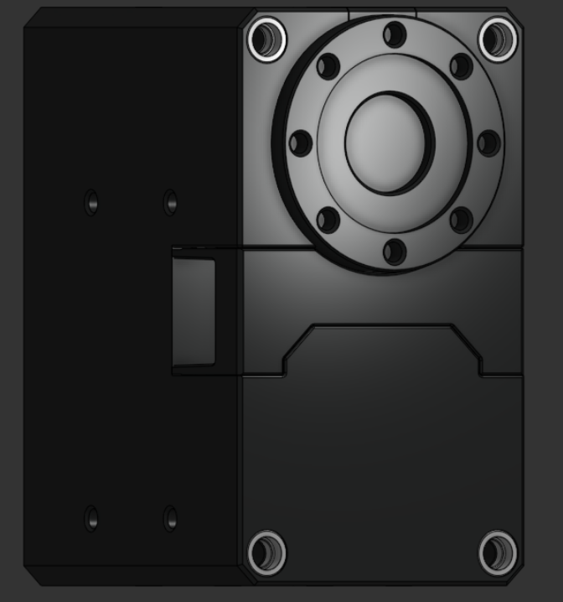
Step 10
Insert four Robotis Spacers into the back of the actuator
Parts
-Robotis XM540-W270-T Actuator
-4x Robotis Spacers

Slide 20
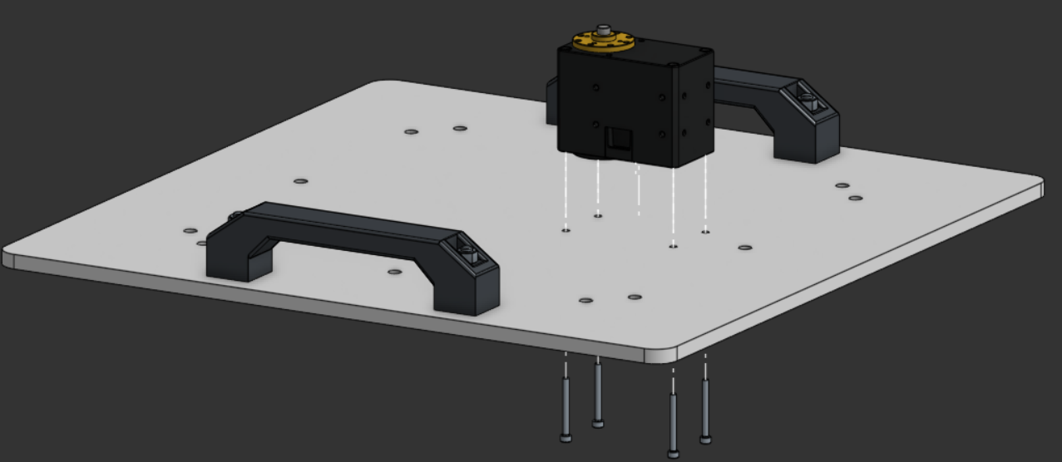
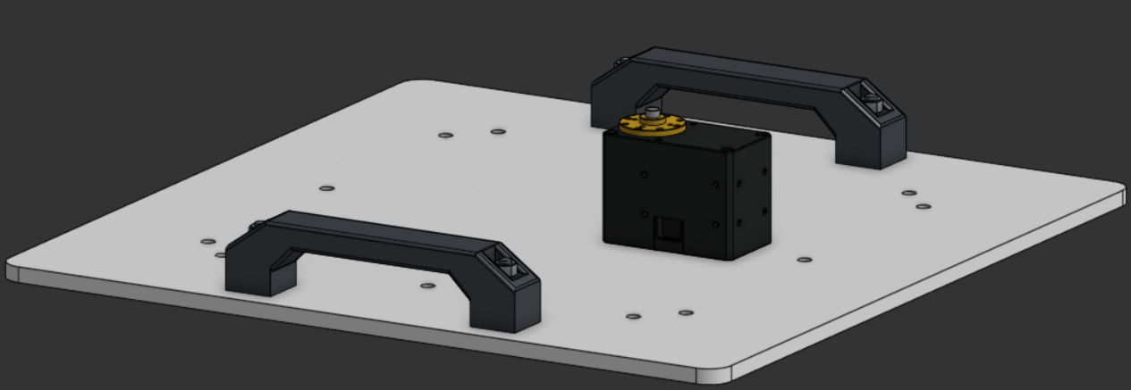
Step 11
Bolt the back of the actuator to the Base Plate
Parts
-Previous step
-Base Plate (with handles)
-4x M2.5x25mm Socket Head Bolt

Slide 21
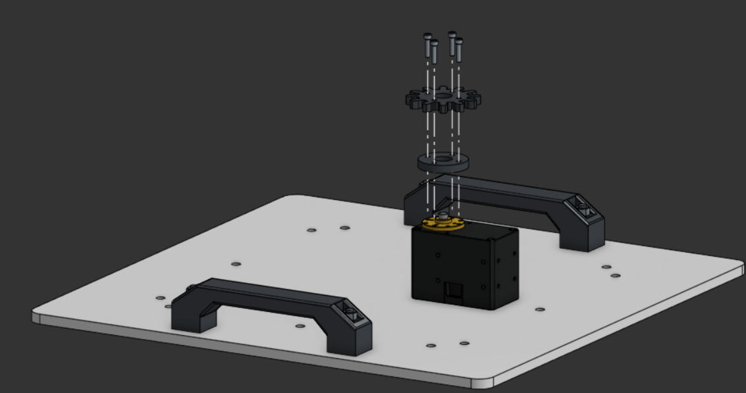
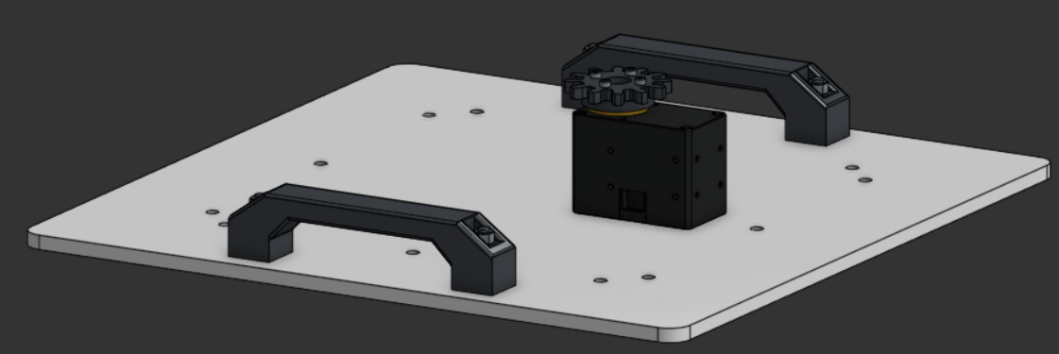
Step 12
Bolt the 12T Gear on top of the Gear Spacer to the actuator
Parts
-Previous step
-12T Gear
-Gear Spacer
-4x M2.5x12mm Socket Head Bolt

Slide 22
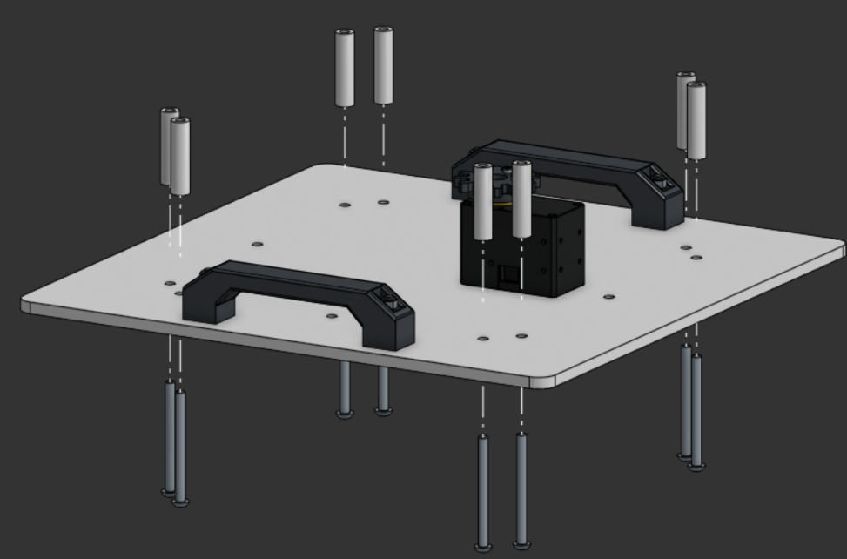
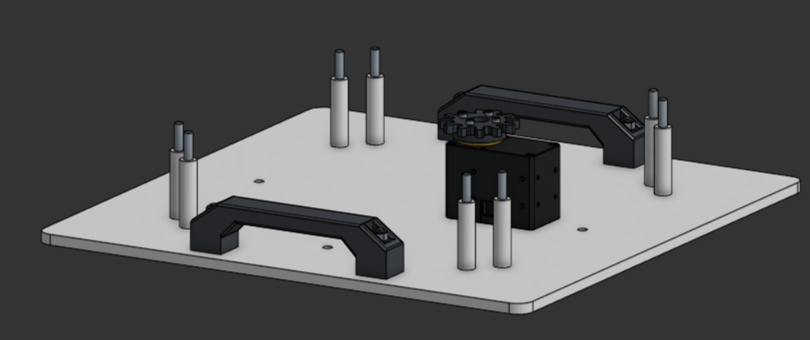
Step 13
Insert M5x60mm Button Head Bolts through eight corner holes, and place 40mm spacers on top
Parts
-Previous step
-8x M5*60mm Button Head Bolt
-8x 5x10x40mm M5 Threaded Spacers

Slide 23
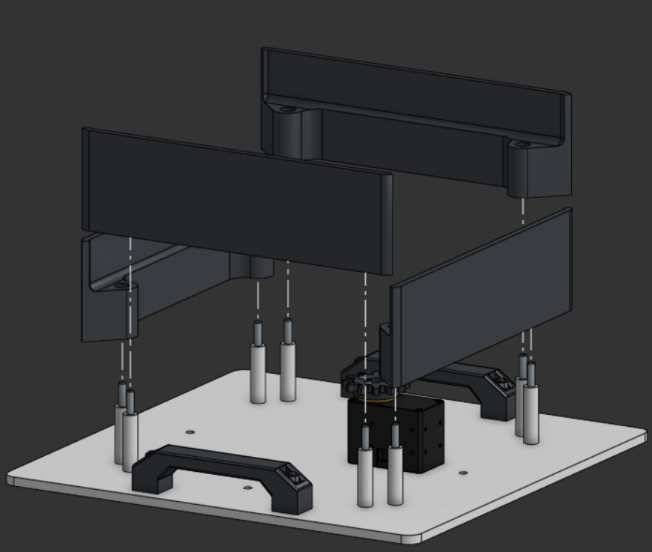
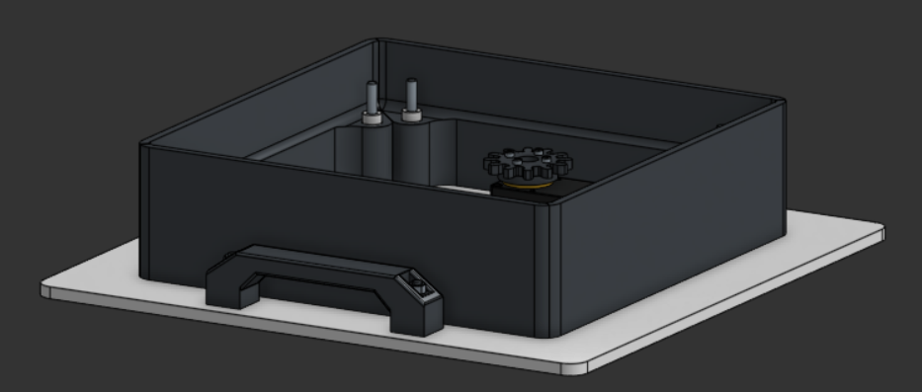
Step 14
Insert Base Walls onto each face of the base
Parts
-Previous step
-4x Base Wall

Slide 24
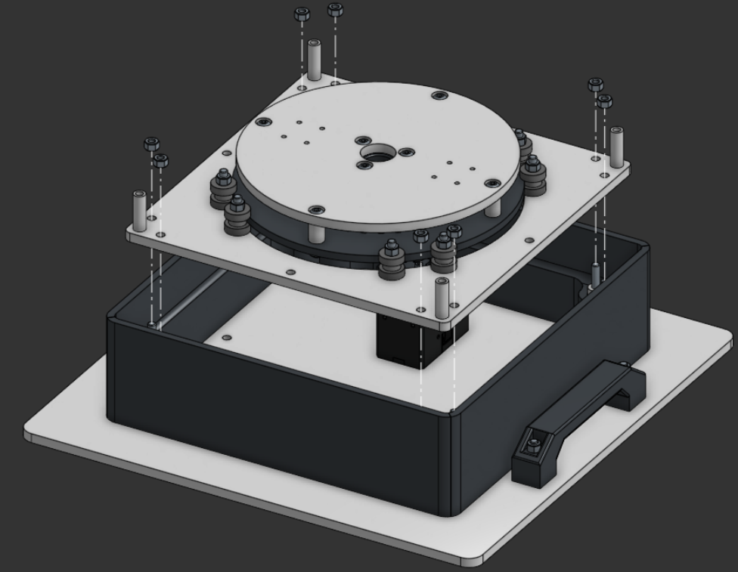
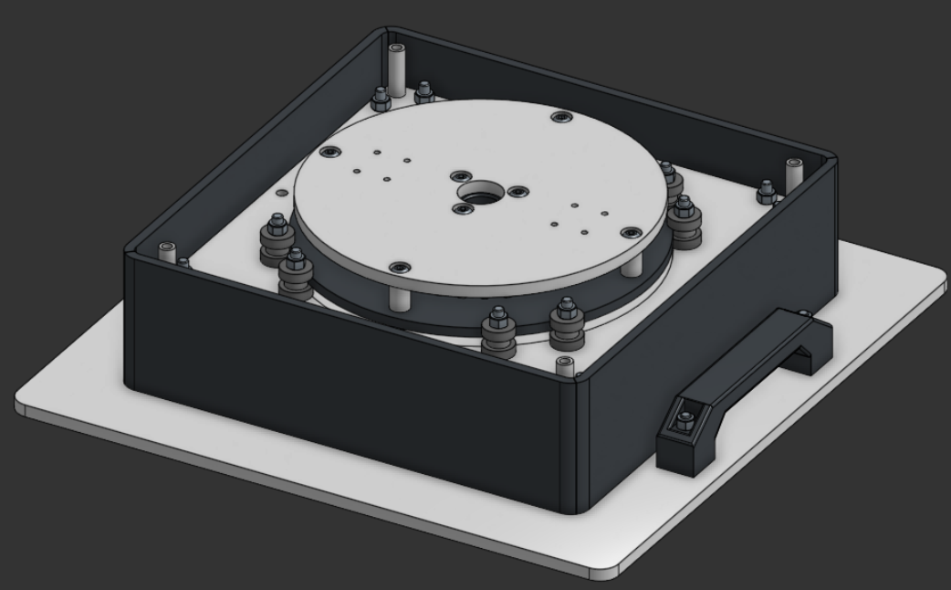
Step 15
Insert the Arm Base Plate Assembly on top of the bolts and attach Nylock nuts
Parts
-Previous step
-Arm Structure Plate and Arm Base Plate Assembly
-8x Nylock Nuts

Slide 25
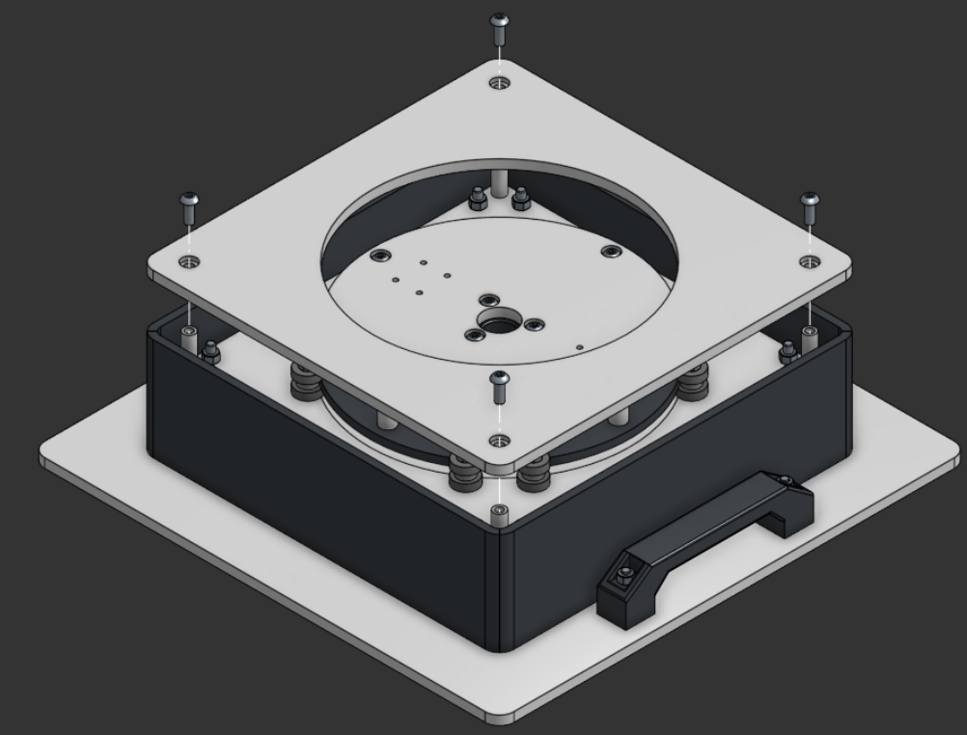
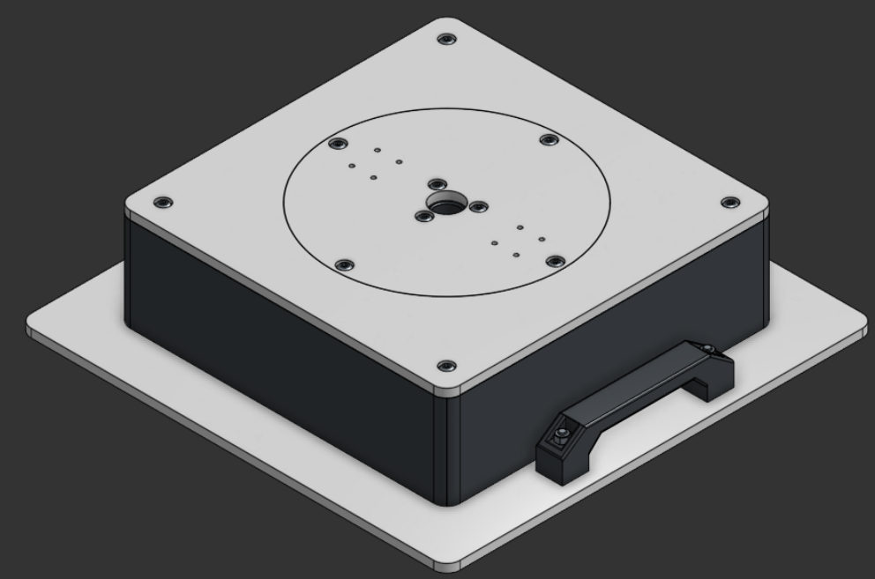
Step 16
Place the Base Top Plate around the Arm Base Plate and bolt each corner
Parts
-Previous step
-4x M5x14mm Button Head Bolt

Slide 26
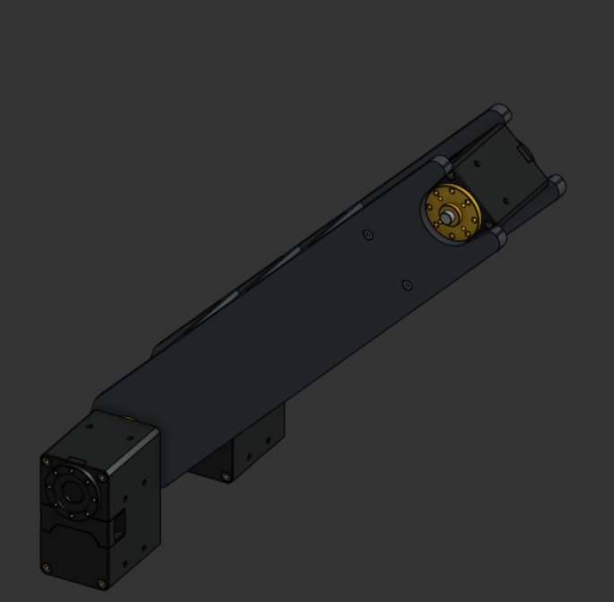
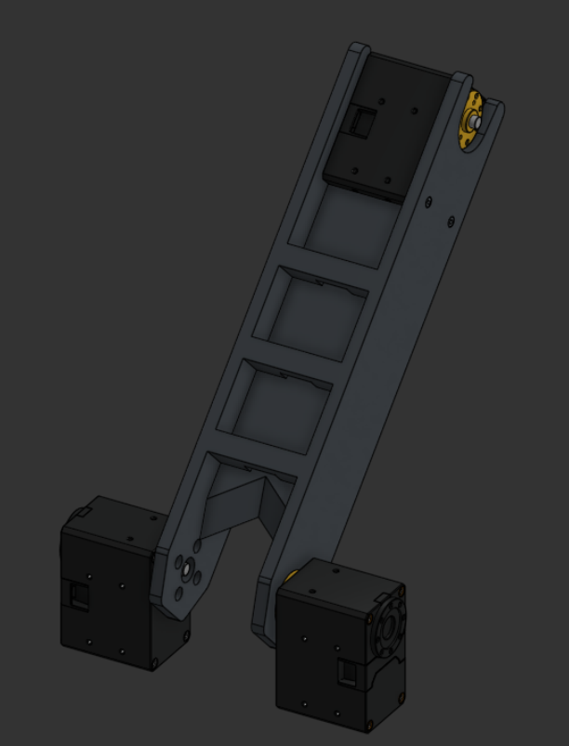
Arm Shoulder Assembly Instructions

Slide 27
Parts
Major Components:
Arm Shoulder Piece
3x Robotis XM540-W270-T Actuator
Minor Components:
8x M2.5x6mm Bolts
4x M2.5x25mm Bolts
4x Robotis Spacers

Slide 28
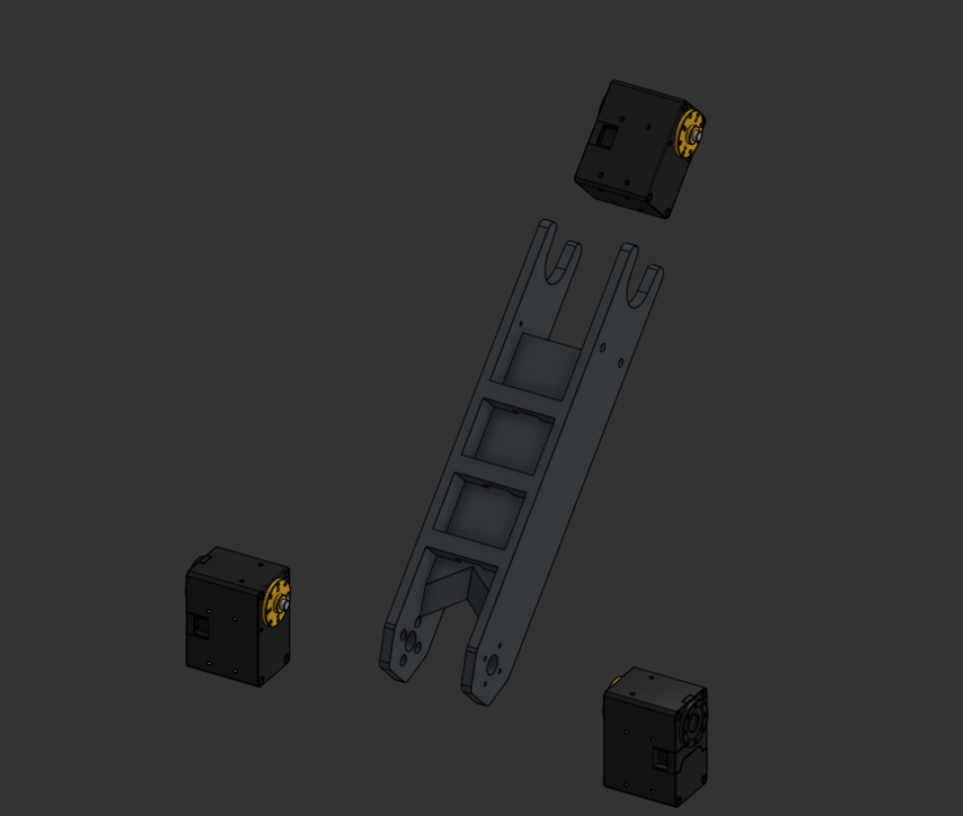
Major Components
Arm Shoulder Piece
Robotis XM540-W270-T Motors

Slide 29
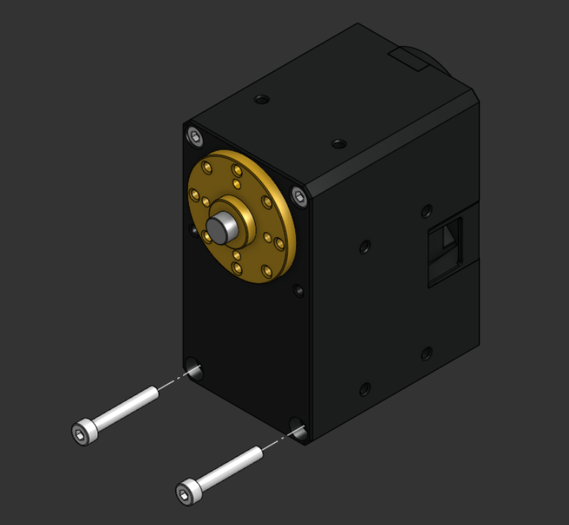
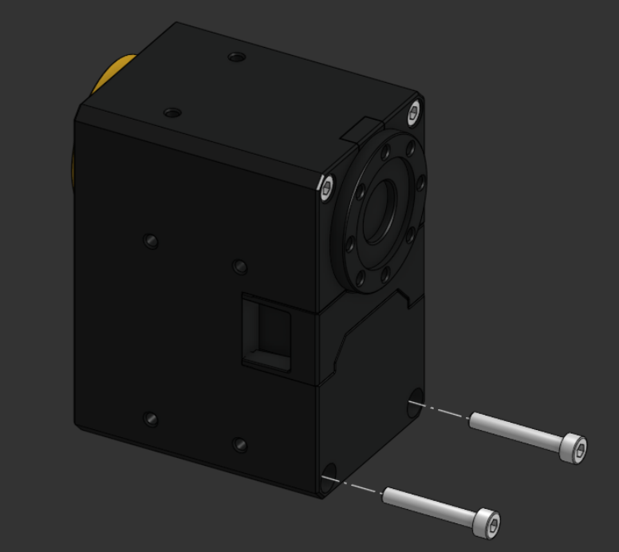
Step 1
Remove the bottom two bolts from both sides of the actuator
Parts
-Robotis XM540-W270-T Actuator

Slide 30
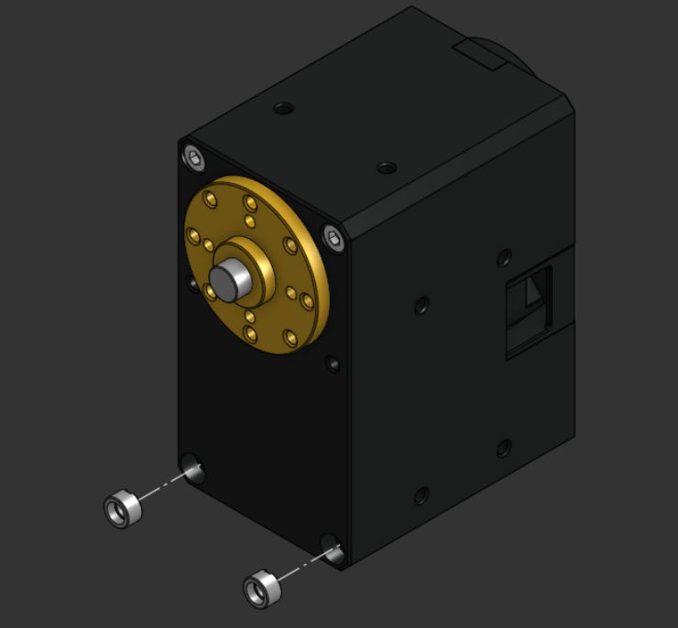
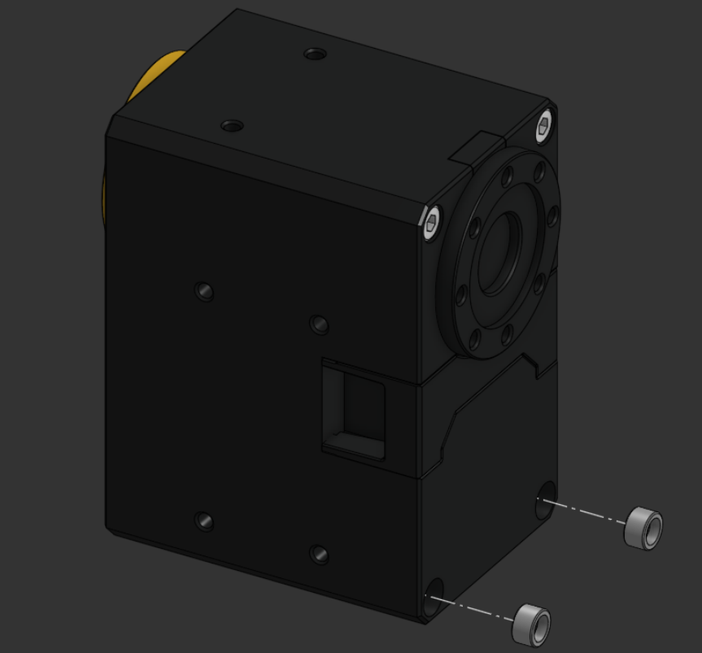
Step 2
Insert spacer rings into the actuator
Parts
-Robotis XM540-W270-T Actuator
-4x Robotis Spacers

Slide 31
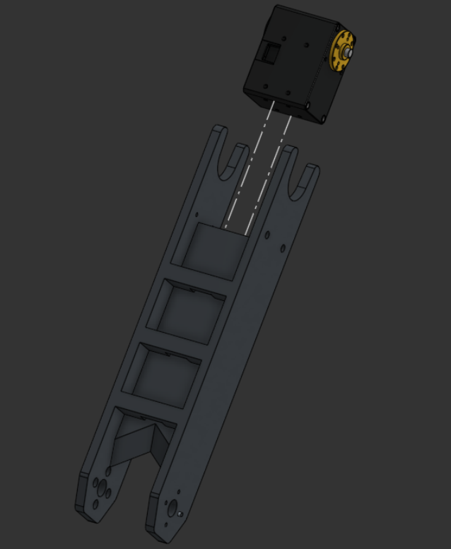
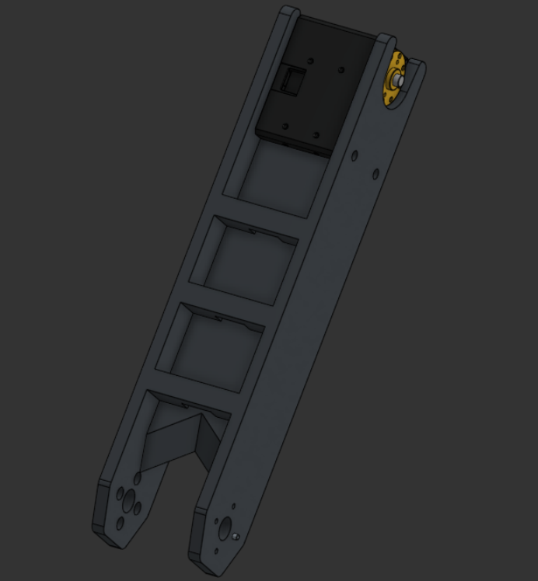
Step 3
Place the actuator in the top of the shoulder piece
Parts
-Previous step
-Arm Shoulder Piece

Slide 32


Step 4
Bolt the actuator into the top of the shoulder piece
Parts
-Previous step
-4x M2.5x25mm Socket Head Bolt

Slide 33


Step 5
Align the actuator with the bottom of the shoulder piece
Parts
-Previous step
-Robotis XM540-W270-T Actuator

Slide 34


Step 6
Bolt the actuator to the bottom of the shoulder piece
Parts
-Previous step
-4x M2.5x6mm Bolts

Slide 35


Step 7
Repeat steps 5-6 for the other actuator
Parts
-Previous step
-Robotis XM540-W270-T Actuator
-4x M2.5x6mm Bolts

Slide 36


Arm Elbow Assembly Instructions

Slide 37
Parts
Major Components:
Arm Elbow Piece
1x Robotis XM540-W270-T Actuator
Minor Components:
8x M2.5x8mm Socket Head Bolt

Slide 38

Major Components
Robotis XM540-W270-T Actuator
Arm Elbow Piece

Slide 39


Step 1
Insert the actuator between the ends of the elbow piece
Parts
-Arm Elbow Piece
-Robotis XM540-W270-T Actuator

Slide 40


Step 2
Bolt the actuator into the ends of the elbow piece
Parts
-Previous step
-4x M2.5x8mm Socket Head Bolt

Slide 41


Arm Gripper Finger Assembly Instructions

Slide 42
Parts
Major Components:
2x Spring
2x Spring Spacer
4x Finger Front Plate
4x Finger Center Plate
2x Front Finger Pad
4x Center Finger Pad (two top pieces, two bottom pieces)
Minor Components:
6x M3x25mm Socket Head Bolt
4x M3x20mm Socket Head Bolt
4x 3x8x4mm Bearing
10x M3 Lock Washer
10x M3 Nut

Slide 43

Major Components
Front Finger Pad
Finger Front Plate
Finger Center Plate
Spring Spacer
Spring
Center Finger Pads

Slide 44


Step 1
Bolt the Front Finger Plates to the Front Finger Pad with a lock washer underneath the nut
Parts
-2x Finger Front Plate
-Front Finger Pad
-2x M3x25mm Socket Head Bolt
-2x M3 Lock Washer
-2x M3 Nut

Slide 45


Step 2
Bolt the Center Finger Plates and Center Finger Pads together with a lock washer underneath the nut
Parts
-2x Finger Center Plate
-2x Center Finger Pad
-2x M3x20mm Socket Head Bolt
-2x M3 Lock Washer
-2x M3 Nut

Slide 46


Step 3
Insert the Spring Spacer into the center of the spring and then align the spring with the end of the Center Finger Plates
Parts
-Previous step
-Spring
-Spring Spacer

Slide 47


Step 4
Align the front section of the finger with the center section
Parts
-Previous step
-Finger Front Assembly

Slide 48


Step 5
Bolt the front and center sections together on top of the bearings with a lock washer underneath the nut
Parts
-Previous step
-M3x25mm Socket Head Bolt
-2x 3x8x4mm Bearing
-M3 Lock Washer
-M3 Nut

Slide 49


Step 6
Repeat steps 1-5 for a mirror finger
Parts
-Previous step
-Front Finger Pad
-2x Finger Front Plate
-2x Finger Center Pads
-2x Finger Center Plate
-Spring
-Spring Spacer
-2x 3x8x4mm Bearing
-2x M3x20mm Socket Head Bolt
-3x M3x25mm Socket Head Bolt
-2x M3 Lock Washer
-2x M3 Nut

Slide 50


Arm Gripper Coiler Assembly Instructions

Slide 51
Parts
Major Components:
2x Spring
2x Spring Spacer
4x Finger Front Plate
4x Finger Center Plate
2x Front Finger Pad
4x Center Finger Pad (two top pieces, two bottom pieces)
Minor Components:
8x M2.5x8mm Bolt

Slide 52

Major Components
Coiler Top
Coiler Bottom
Pulleys

Slide 53


Step 1
Bolt the Coiler Top to the pulleys and Coiler Bottom
Parts
-Coiler Top
-Coiler Bottom
-2x Pulley
-2x M3x14mm Socket Head Bolt
-2x M3 Nut

Slide 54


Step 2
Bolt the Coiler to the horn of the actuator
Parts
-Previous step
-Robotis XM540-W270-T Actuator
-4x M2.5x8mm Socket Head Bolt

Slide 55


Arm Gripper Base Assembly Instructions

Slide 56
Parts
Major Components:
Coiler Assembly
Gripper Base Top Plate
Gripper Base Bottom Plate
Gripper Base Front
2x Gripper Base Side Wall
2x Pulley
2x Pulley Spacer
Minor Components:
2x M3x10mm Socket Head Bolt
4x M3x25mm Socket Head Bolt
6x M3 Lock Washer
6x M3 Nut

Slide 57

Major Components
Pulleys
Gripper Base Top Plate
Gripper Base Front
Gripper Base Side Wall
Gripper Base Bottom Plate
Pulley Spacers
Coiler Assembly

Slide 58


Step 1
Remove the front four bolts from the actuator
Parts
-Coiler Assembly

Slide 59


Step 2
Insert Robotis Spacers into the front of the actuator
Parts
-Previous step
-4 Robotis Spacers

Slide 60


Step 3
Bolt the Front Finger Plates to the Front Finger Pad with a lock washer underneath the nut
Parts
-Gripper Base Bottom Plate
-Gripper Base Front
-2x M3x10mm Socket Head Bolt
-2x M3 Lock Washer

Slide 61


Step 4
Bolt the Gripper Base Bottom Plate to the actuator
Parts
-Previous step
-Coiler Assembly with spacers
-4x M2.5x16mm Socket Head Bolt

Slide 62


Step 5
Bolt the Front Finger Plates to the Front Finger Pad with a lock washer underneath the nut
Parts
-Previous step
-Gripper Base Side Wall
-2x M3x25mm Socket Head Bolt
-2x Lock Washer
-2x M3 Nut

Slide 63


Step 6
Bolt the pulley and pulley spacers to the front of the Gripper Base
Parts
-Previous step
-3x12x4mm Pulley
-2x Pulley Spacer
-M3x25mm Socket Head Bolt
-M3 Lock Washer
-M3 Nut

Slide 64


Step 7
Repeat for the other side
Parts
-Previous step
-3x12x4mm Pulley
-2x Pulley Spacer
-M3x25mm Socket Head Bolt
-M3 Lock Washer
-M3 Nut

Slide 65

Arm Gripper Assembly Instructions

Slide 66
Parts
Major Components:
Gripper Base Assembly
2x Gripper Finger Assembly
2x Spring
2x Spring Spacer
Minor Components:
2x M3x25mm Socket Head Bolt
2x M3 Lock Washer
2x M3 Nut

Slide 67

Major Components
Spring Spacer
Gripper Finger Assembly
Gripper Base Assembly
Spring

Slide 68


Step 1
Insert a spring spacer into the spring and align the spring with the end of the finger assembly
Parts
-Gripper Finger Assembly
-Spring
-Spring Spacer

Slide 69


Step 2
Insert the end of the spring into the Gripper Base Side Wall
Parts
-Previous step
-Gripper Base Assembly

Slide 70


Step 3
Bolt the finger and two bearings to the gripper base with a lock washer and nut underneath
Parts
-Previous step
-M3x25mm Socket Head Bolt
-2x 3x8x4mm Bearing
-M3 Lock Washer
-M3 Nut

Slide 71


Step 4
Repeat steps 1-3 for the other finger
Parts
-Previous step
-Gripper Finger Assembly
-M3x25mm Socket Head Bolt
-2x 3x8x4mm Bearing
-M3 Lock Washer
-M3 Nut

Slide 72


Arm Assembly Instructions

Slide 73
Parts
Major Components:
Gripper Assembly
Base Assembly
Shoulder Assembly
Elbow Assembly
Intel Realsense D435i Camera
Camera Mount
Upper Wrist Mount
Center Wrist Mount
Minor Components:
14x M2.5x6mm Socket Head Bolt
10x M2.5x8mm Socket Head Bolt
2x M2.5x14mm Socket Head Bolt
2x M3x25mm Socket Head Bolt
2x M3x10mm Socket Head Bolt
2x M3 Lock Washer
2x M3 Nut
2x M2.5 Lock Washer
2x M2.5 Nut

Slide 74

Major Components
Camera + Mount
Elbow Assembly
Gripper Assembly + Wrist Mounts
Base Assembly
Shoulder Assembly

Slide 75


Step 1
Attach the Center Wrist mount to the Elbow Assembly using 4 bolts
Parts
-Elbow Assembly
-Center Wrist Mount
-4x M2.5x6mm Socket Head Bolts

Slide 76


Step 2
Bolt the Upper Wrist Mount to the Gripper Assembly
Parts
-Top Wrist Mount
-Gripper Assembly
-2x M3x25mm Socket Head Bolts
-2x M3 Lock Washer
-2x M3 Nut

Slide 77


Step 3
Bolt the Upper Wrist Mount to the Center Wrist Mount
Parts
-Previous step
-2x M2.5x14mm Socket Head Bolt
-2x M2.5 Lock Washer
-2x M2.5 Nut

Slide 78


Step 4
Bolt the bottom of the Center Wrist Mount to the gripper actuator
Parts
-Previous step
-2x M2.5x8mm Socket Head Bolt

Slide 79


Step 5
Align the Elbow Assembly with the Shoulder Assembly
Parts
-Previous step
-Shoulder Assembly

Slide 80


Step 6
Bolt the Elbow Assembly to the Shoulder Assembly
Parts
-Previous step
-8x M2.5x6mm Socket Head Bolt

Slide 81


Step 7
Bolt the Shoulder Assembly to the Arm Base Assembly
Parts
-Previous step
-Arm Base Assembly
-8x M2.5x8mm Socket Head Bolt

Slide 82


Step 8
Bolt the Camera Mount to the back two holes of the elbow actuator
Parts
-Previous step
-Camera Mount
-2x M2.5x6mm Socket Head Bolt

Slide 83


Step 9
Bolt the camera to the Camera Wrist Mount
Parts
-Previous step
-Intel Realsense D435i Camera
-2x M3x10mm Socket Head Bolt

